Slide 1
E-commerce support artificial intelligence
Supervised by :
DR / Enas Farouk

Slide 2

Agenda
Introduction
Login / Registration
Home page
Cart / Checkout
Recommendation system
Chatbot / FAQ

Slide 3
Introduction :
What is E-Commerce?
E-commerce, short for electronic commerce, is like having a virtual shopping mall right at your fingertips. It's all about buying and selling goods and services online. Just think about all the stuff you can buy on websites like Amazon, eBay, or even directly from brands' websites—that's e-commerce in action!
Why is E-Commerce Important?
E-commerce has completely changed the way we shop. Instead of having to go to physical stores, we can now shop from the comfort of our homes or even on the go using our phones. It's super convenient and saves us time and effort. Plus, it opens up a whole world of products and services from all over the globe, giving us more choices than ever before !

Slide 4
How Does E-Commerce Work?
Ever wondered how those online shops actually work?
Here's a simplified explanation:
The Online Store: This is like the digital storefront where you browse and buy stuff. It's where you see all the products, read about them, and decide what you want to buy.
Adding to Cart: Just like in a physical store where you put items in your shopping cart, in e-commerce, you click a button to add items to your virtual shopping cart.
Checkout: When you're done shopping, you go to the checkout. Here, you provide your shipping address, payment details, and any other necessary information to complete the purchase.
Payment Processing: Once you've entered your payment details, the e-commerce system securely processes your payment. It makes sure everything is legit and then charges your card or transfers money from your account.
Order Fulfilment: After the payment is processed, the e-commerce system sends a notification to the seller, letting them know that you've made a purchase. The seller then gets the item ready for shipping and sends it to you.
Delivery: Finally, the item is delivered to your doorstep. Depending on where you live and the shipping method chosen, it might take a few days or even just a few hours for your order to arrive.
E-commerce has revolutionized the way we shop, making it easier, more convenient, and more accessible than ever before. Whether you're buying clothes, electronics, groceries, or even services like booking flights or ordering food, e-commerce has something for everyone. So, next time you're shopping online, remember all the behind-the-scenes magic that makes it all possible!

Slide 5
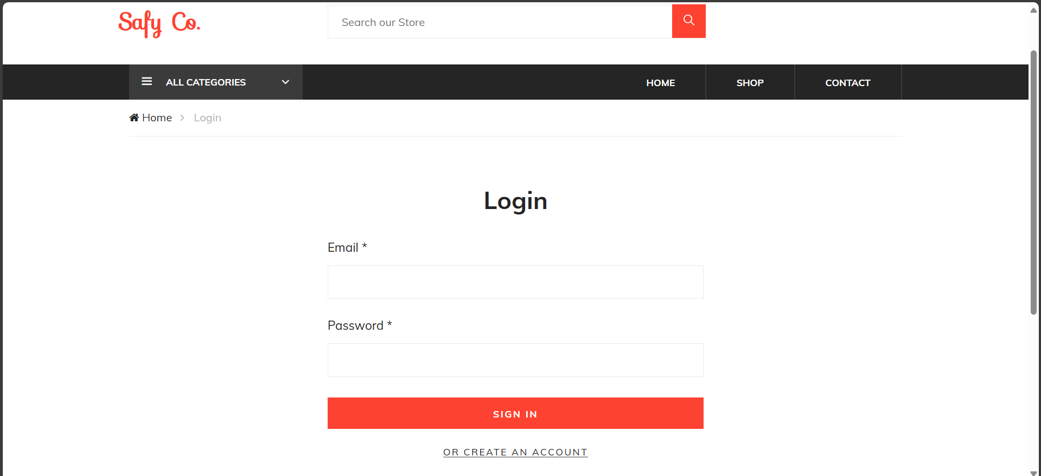

Slide 6
Login Page :
User Interface (UI) Design:
Clean and intuitive layout
Placement of username/email and password fields
Consistent branding (logo, colors, fonts)
User Experience (UX) Features:
Easy navigation to login page
Clear error messages and guidance
Show/hide password option
User Authentication:
Verifies user identity
Ensures secure access to the system
Collects username/email and password

Slide 7
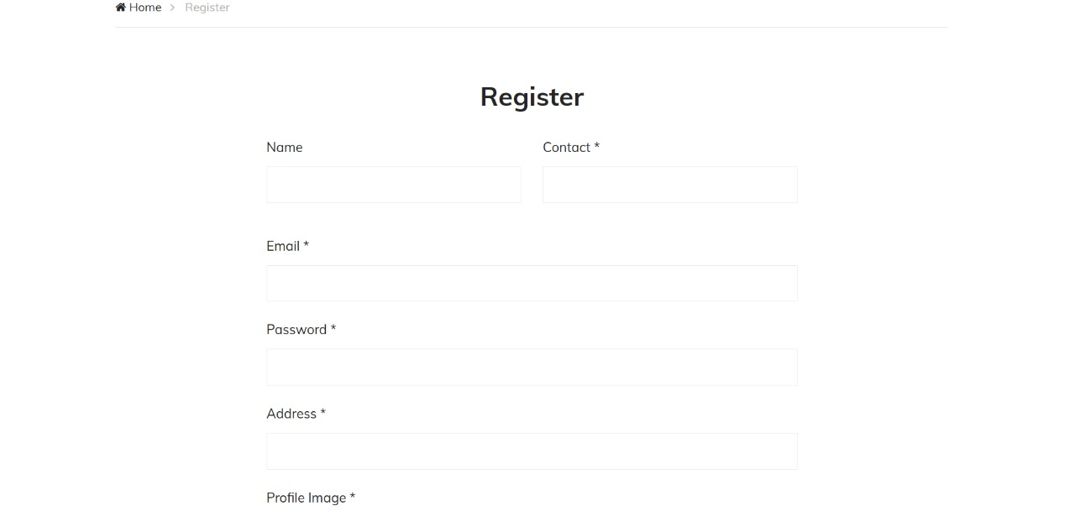

Slide 8
Registration Page :
Breadcrumb Section:
This section displays the navigation path to the current registration page, showing "Home" and "Register".
Register Section:
This section provides a registration form where users can enter their details to create a new account. It includes fields for name, contact, email, password, address, and profile image. It also includes a link to the login page for users who already have an account.

Slide 9
Registration Page :
Database Interaction:
Secure storage of user
dataHandling of unique identifiers (e.g., email)
Data validation before storage
User Information Collection:
Basic details: name, email, password
Optional details: address, phone number

Slide 10
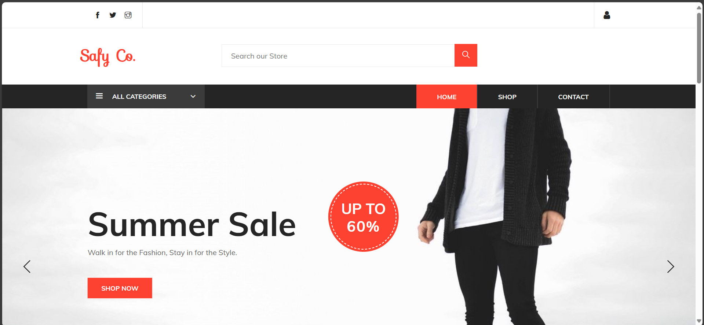

Slide 11
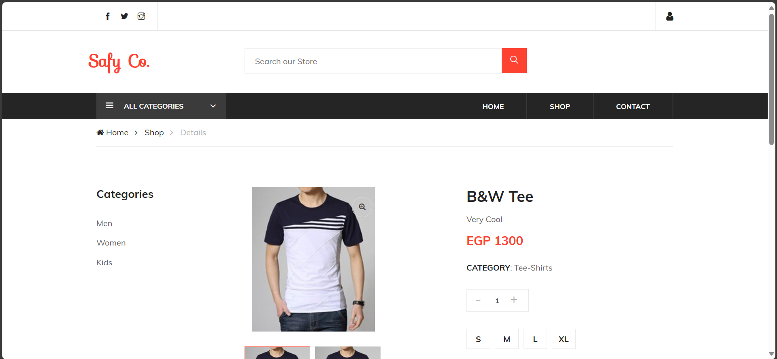

Slide 12
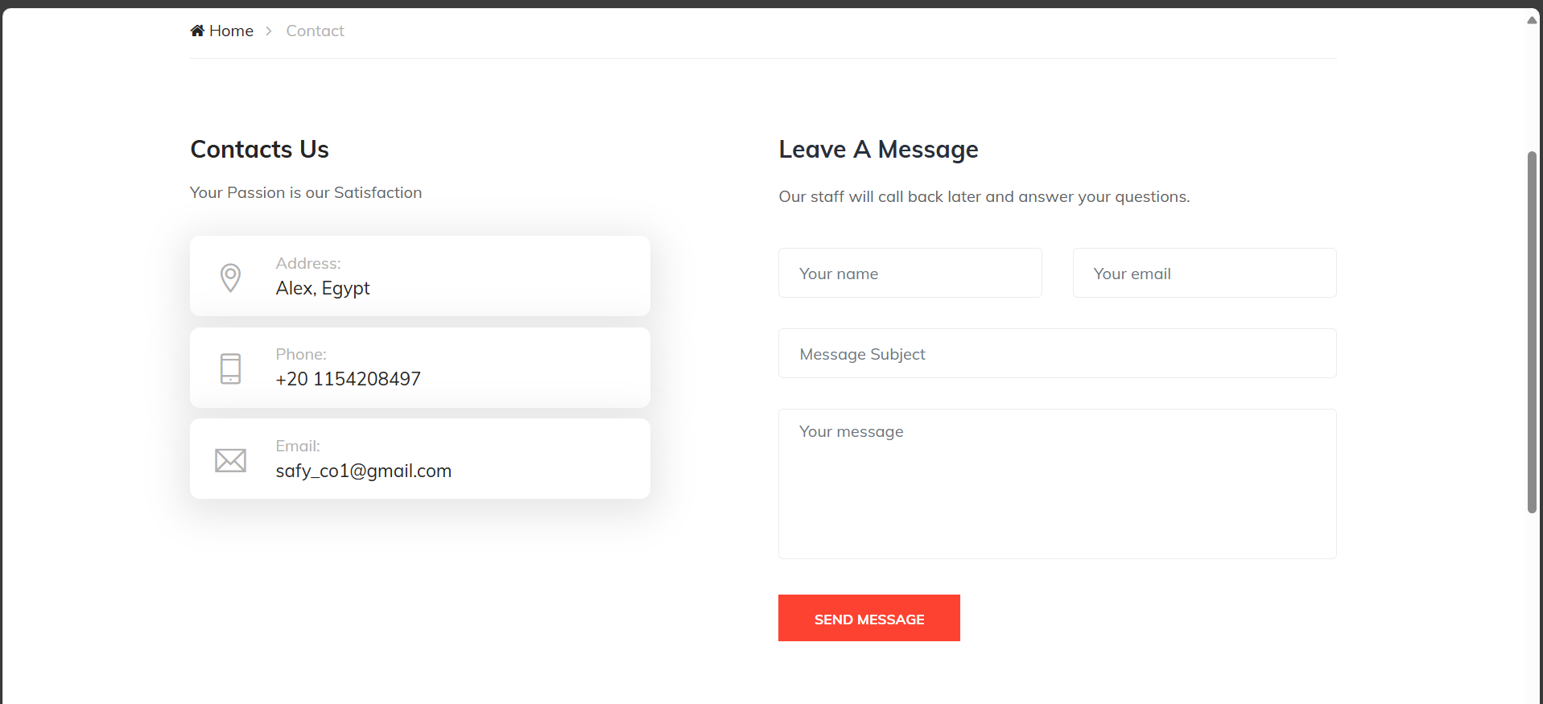

Slide 13
Home Page :
HTML Head Section:
This section sets up the document with metadata, title, Google Fonts, an icon, and CSS styles.
Body Section and Page Preloader:
This part defines a preloader that is displayed while the page is loading.
Header Section:
This part defines the top bar of the header section, including social media links and user login/logout functionality.
Middle Bar of Header:
This part includes the middle bar of the header, featuring the company logo, search bar, and shopping cart details

Slide 14
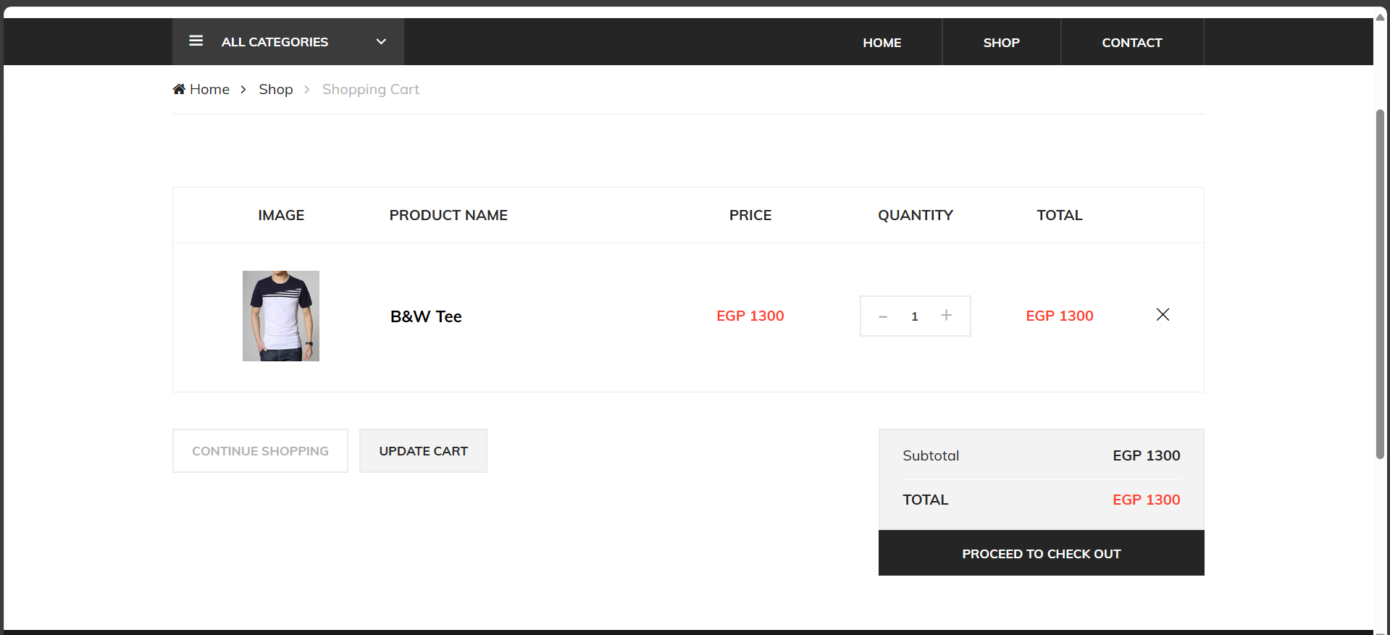

Slide 15
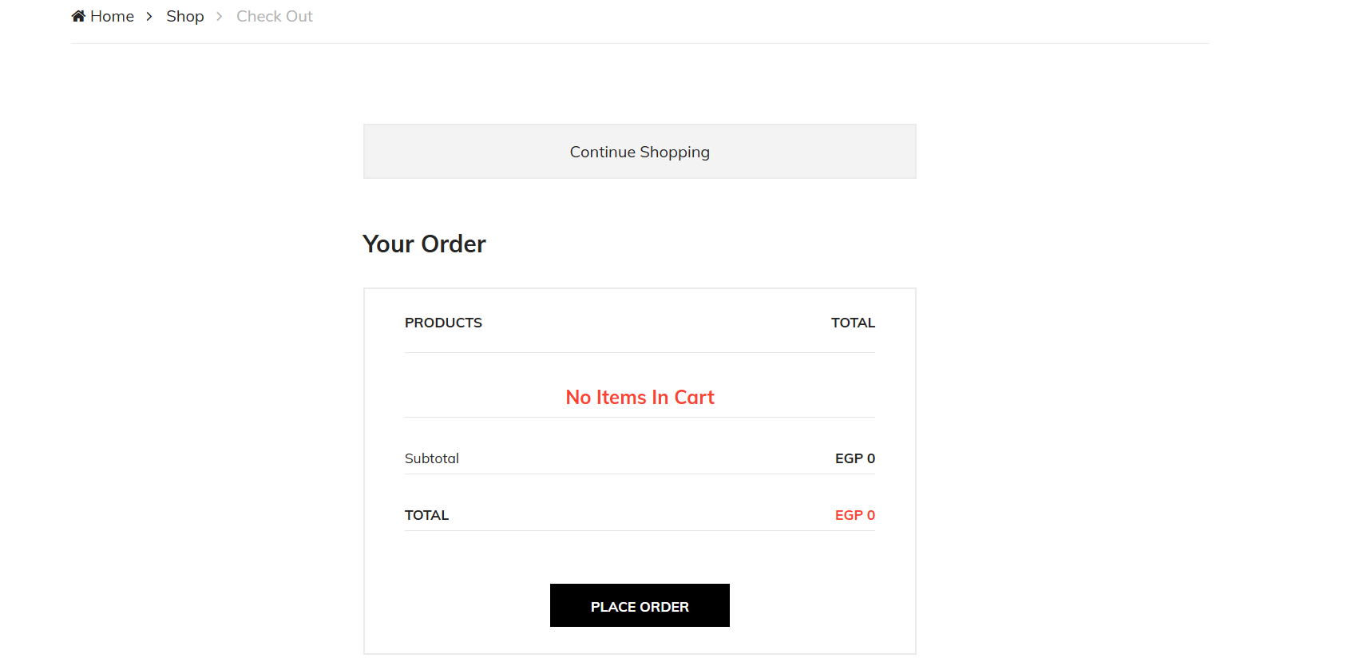

Slide 16
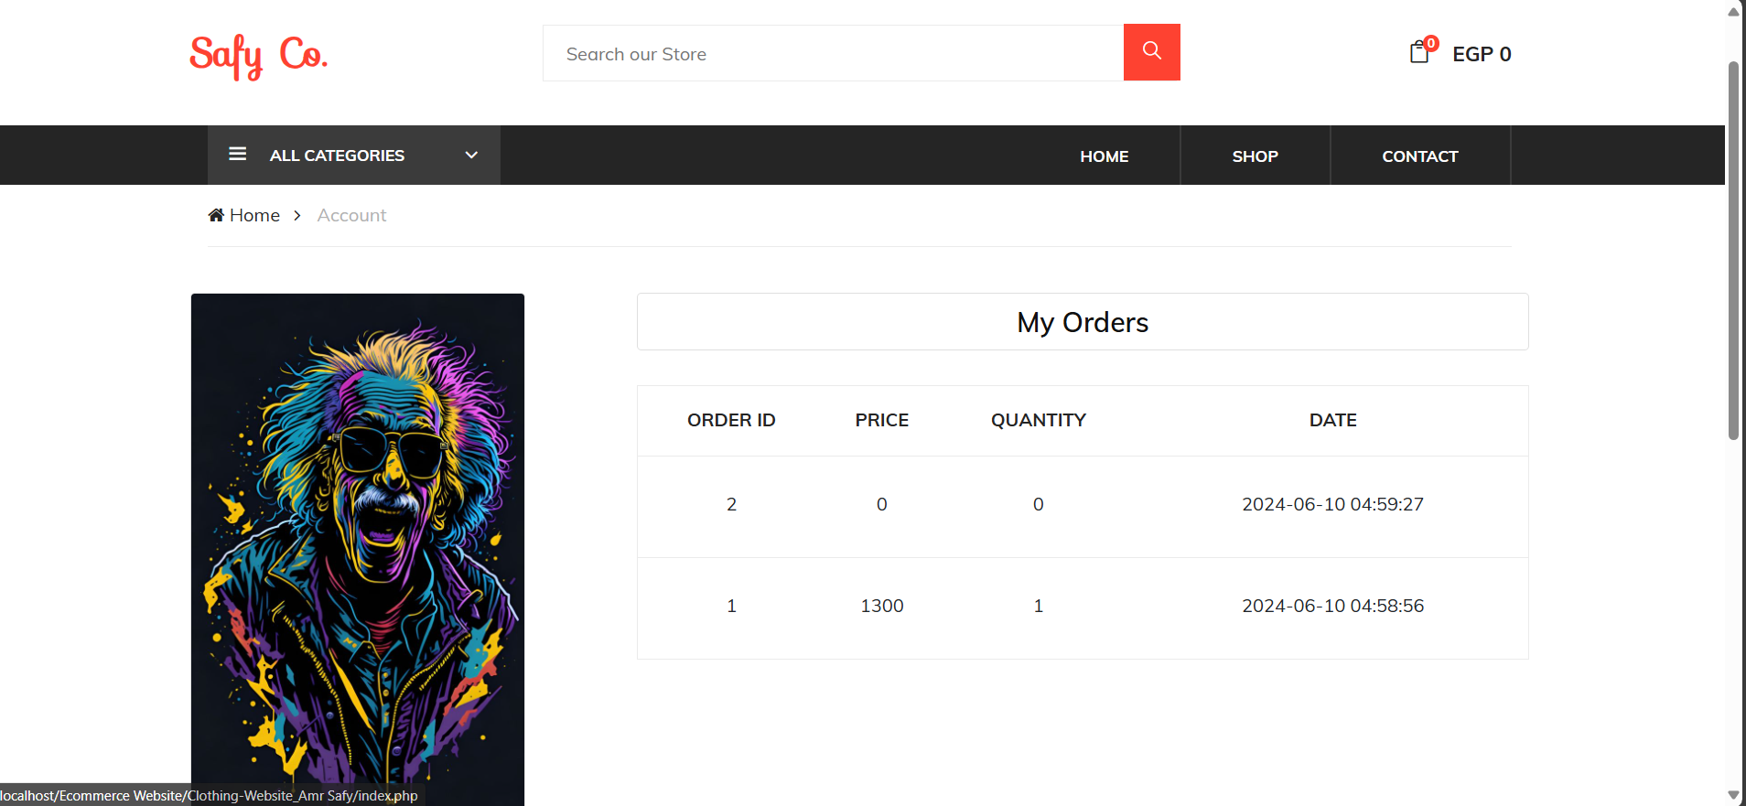

Slide 17
Cart/Checkout :
User Convenience:
Simple design
Easy item management
Real-Time Updates:
Automatic totals calculation
Immediate tax and shipping updates
Order Review:
Summary before purchase
UX Features:
Guest checkout
Save cart option

Slide 18
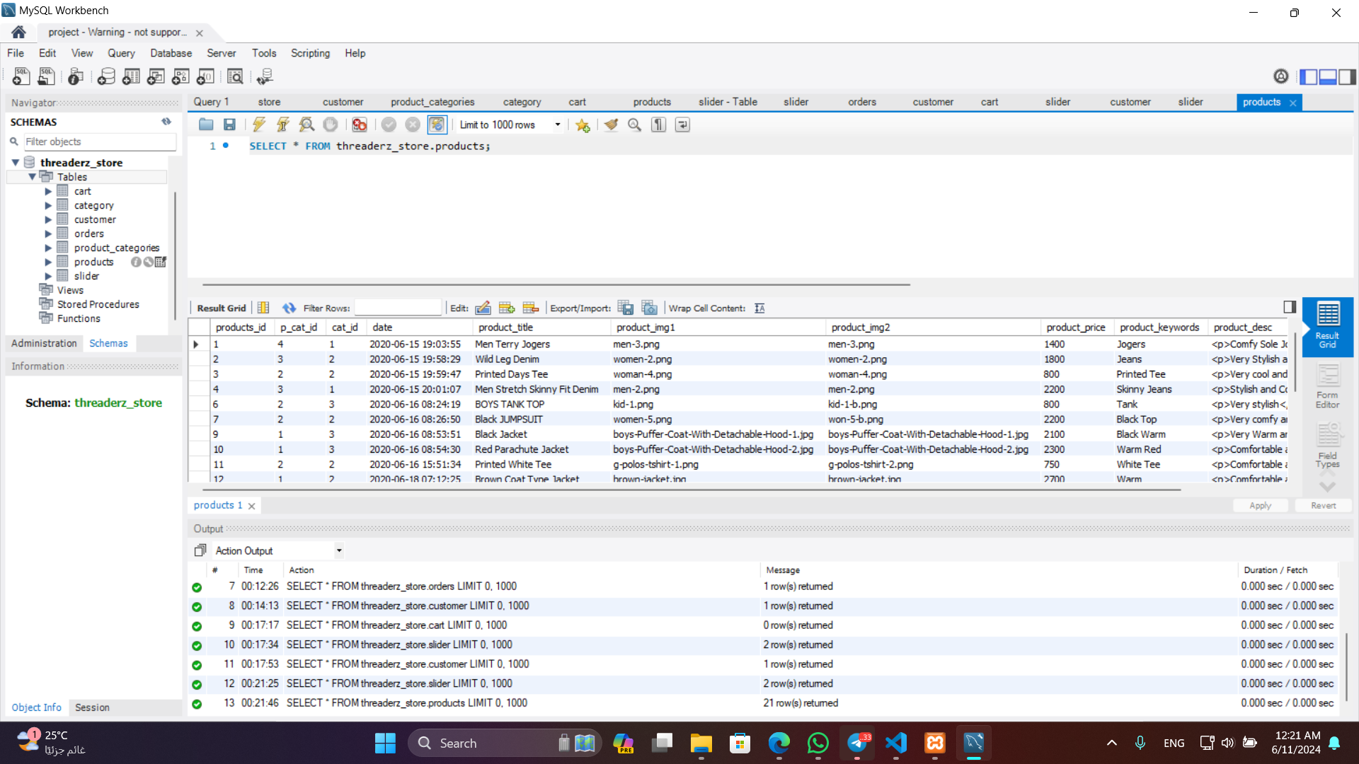

Slide 19
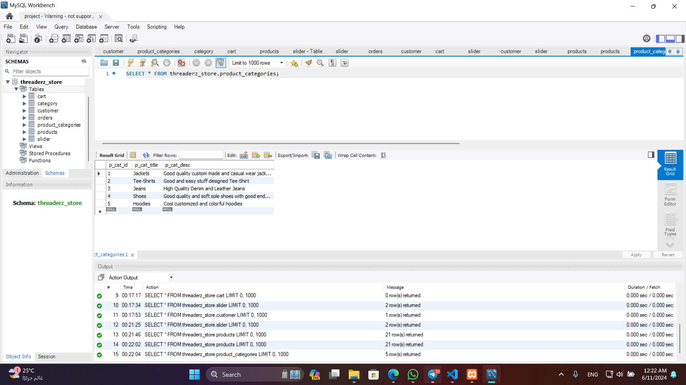

Slide 20
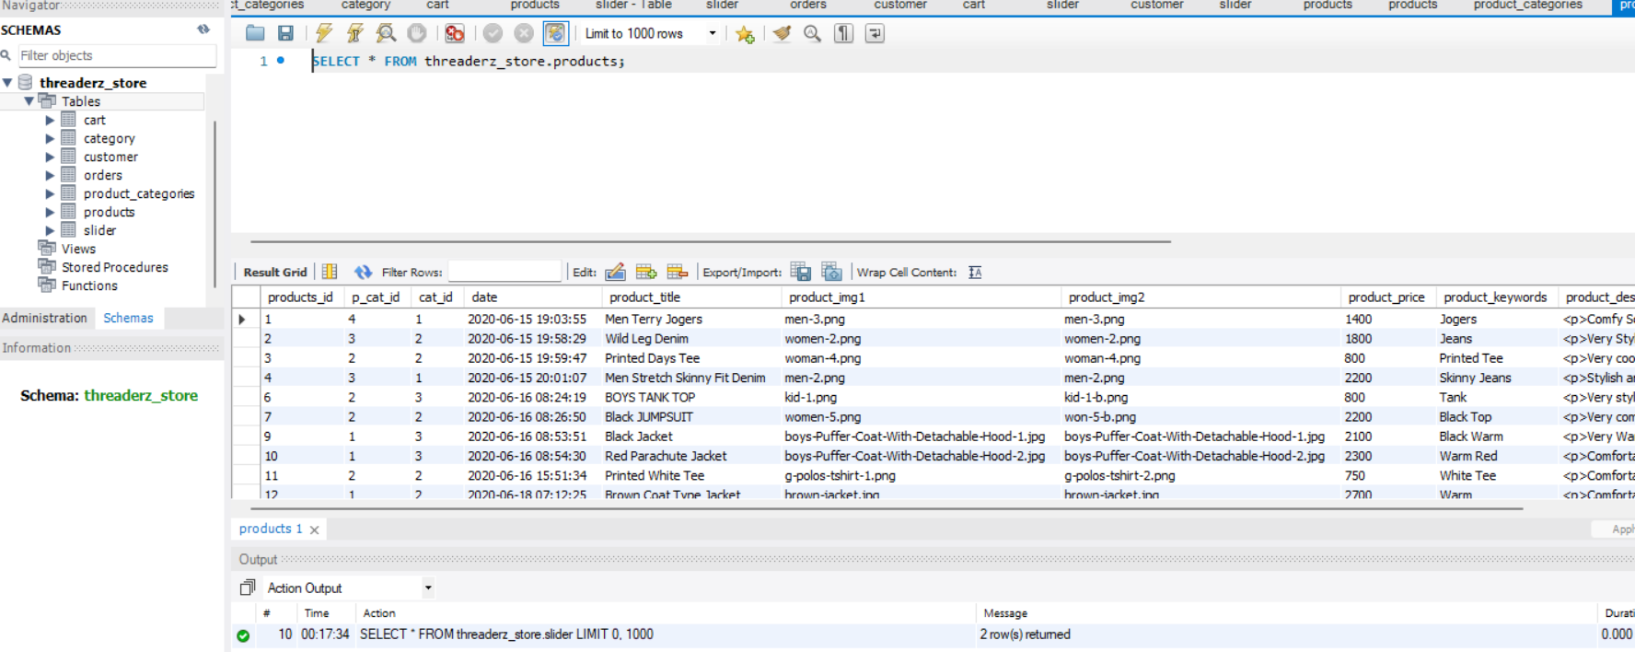

Slide 21
My SQL :
Reliability and Stability:
Proven track record of stability
Trusted by major companies and websites
Performance:
High-speed data processing
Efficient handling of large volumes of data
Security:
Robust security features and encryption
Regular updates to address vulnerabilities

Slide 22
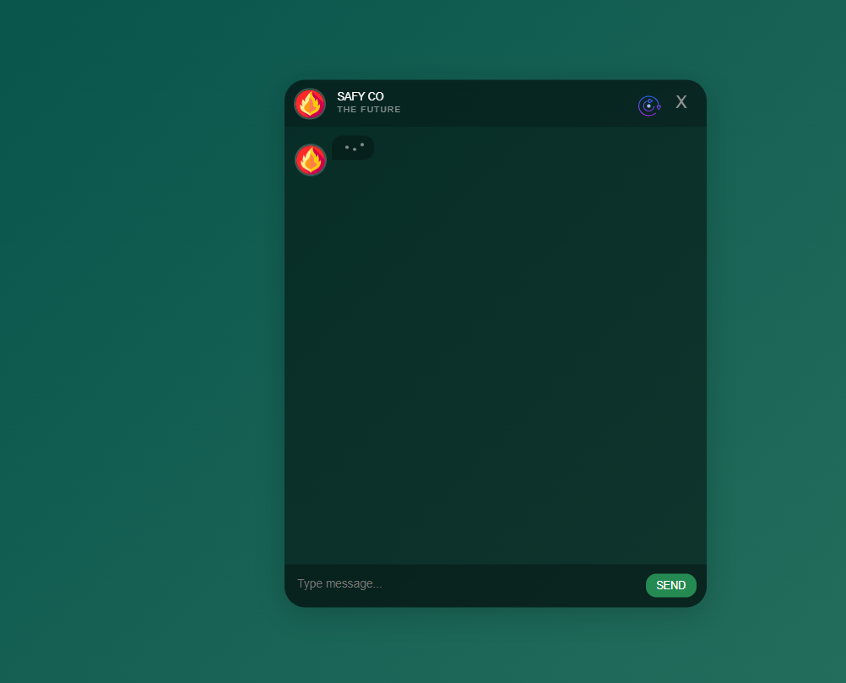
FAQ :
Improves Customer Experience:
Provides quick answers to common questions
Reduces customer frustration
Reduces Support Load:
Decreases the volume of support tickets and calls
Allows support staff to focus on more complex issues
Saves Time:
Provides immediate information to users
Reduces the need for repetitive responses from the support team
Improves Sales and Conversion Rates:
Addresses potential barriers to purchase
Provides clarity on product features, policies, and procedures

Slide 23
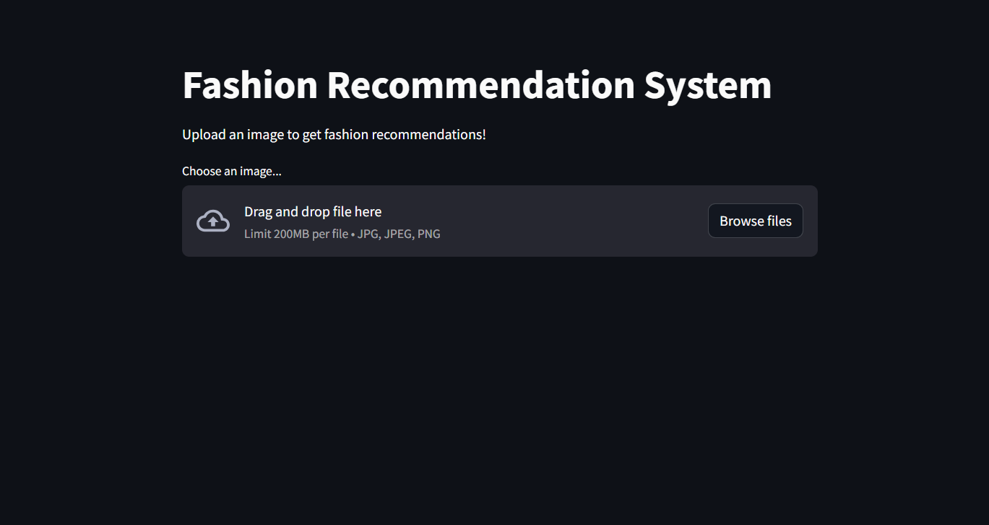
Recommendation System :
Data Collection and Pre-processing
Algorithm Selection and Training
Real-time Recommendation Generation
Integration with User Interface

Slide 24
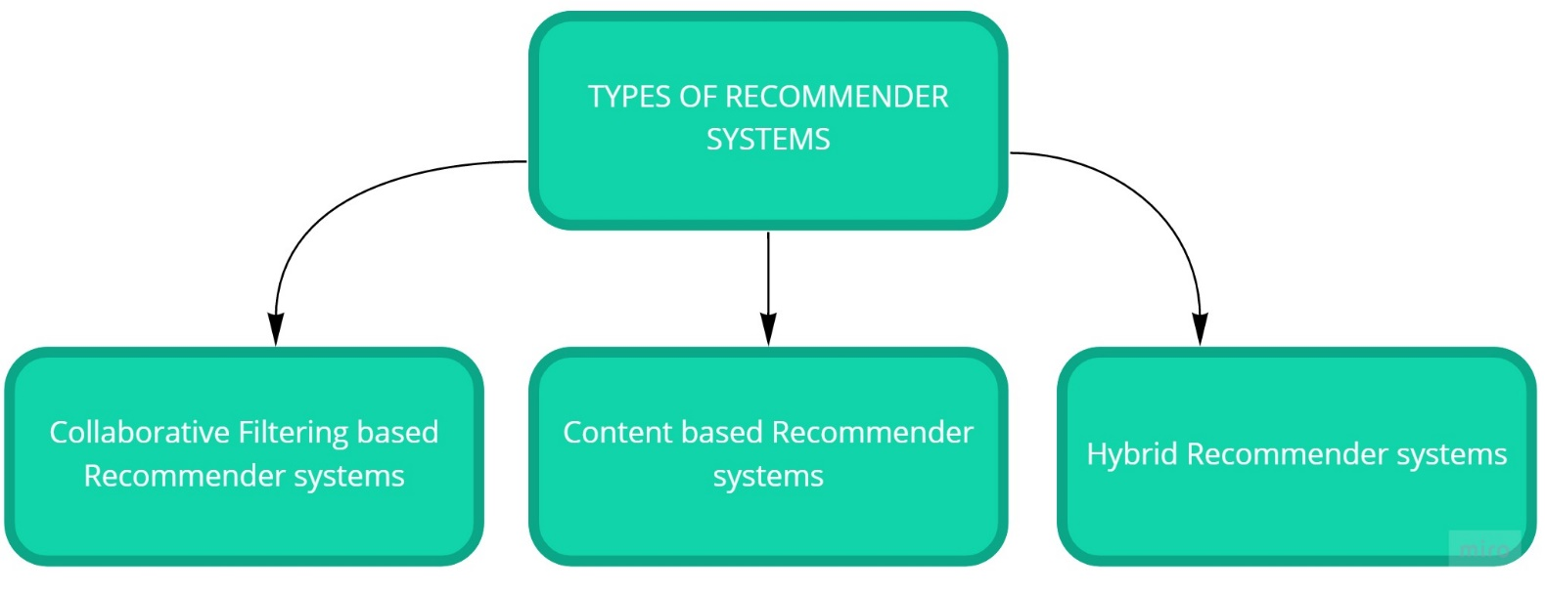
Types of Recommender System

Slide 25
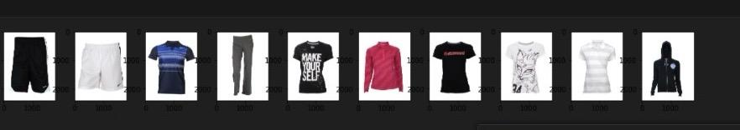
Deep learning Process
1.Understand the problem
2.Identify data

Slide 26
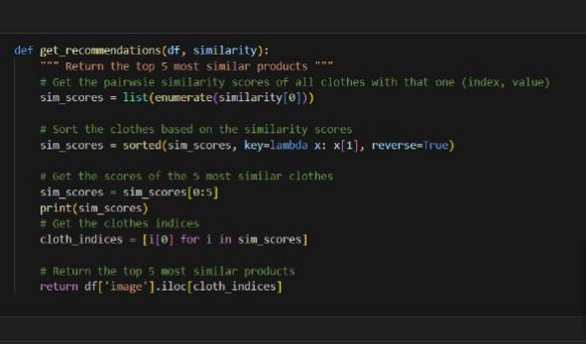
3.Select deep learning algorithm (VGG16)
4.Training the model
5.Test the model

Slide 27
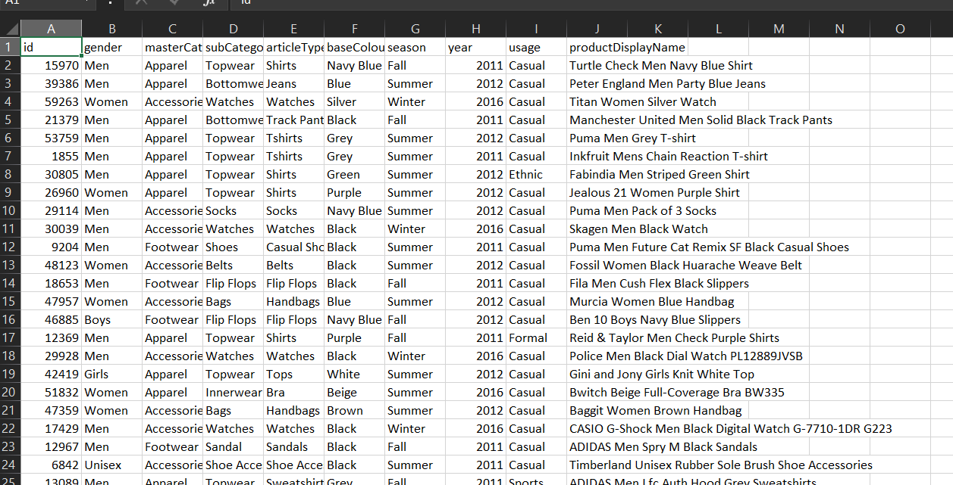

Slide 28
Thank you

